Slide 1
Data Marsh Mallows
Real Time Network Voice Call Quality Data

Slide 2
Agenda
Overview of Dataset
EDA
Model - Random Forest n KNN
Evaluation
Conclusion

Slide 3


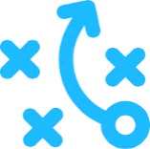
Dataset Overview | Network Voice Call Quality
Objectives
Network Performance Monitoring : Comparison of Expected Performance verse Actual Performance
Enables Network Operators to compare their performance in comparison and invest accordingly to improve their market share. This would enable a competitive and fair marketplace across India
Definition
This data captures the Customers Feedback using TRAI (Telecom regulatory authority of India) MyCAll App. Customers rates their experience about voice call quality in real time and help TRAI gather customer experience data along with Network data.
The data is captured for various service providers, at multiple locations, network types 3G, 4G, 2G, ratings, coordinates etc. The data attached is for two different months.
Measurements
Prediction of Voice Call Quality Category given the Operator, Network Type, and position of the customer

Slide 4
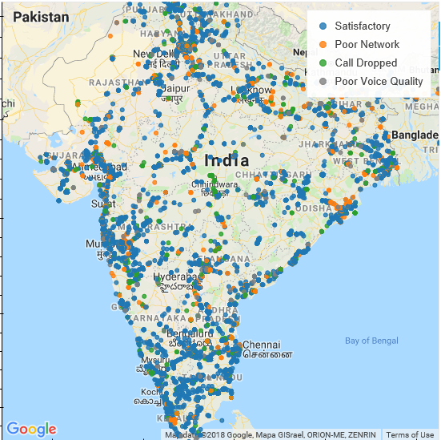
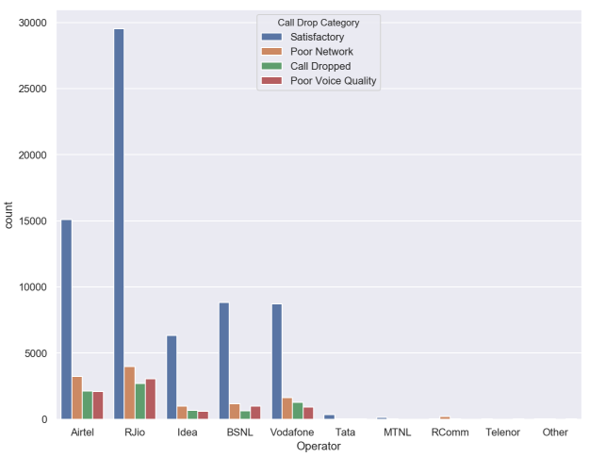
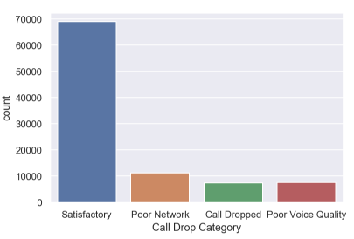
EDA

Slide 5
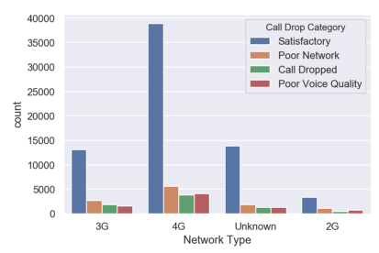
EDA

Slide 6
Model1 | Random Forest Tree
Model Accuracy
precision recall f1-score support
1 0.90 0.91 0.90 16527
2 0.61 0.56 0.58 1586
3 0.54 0.49 0.51 1796
4 0.69 0.68 0.68 3456
avg / total 0.82 0.82 0.82 23365
Where 4 is dropped Call and 1 is Satisfactory
Model Categories used
Latitude and Longitude
Network Type
Operator
Coverage Type (Indoor/Outdoor)
State within India
Random Forest
Model Sumary
The recall on our prediction for Dropped Calls is fairy low due the imbalance in our dataset.
Although the accuracy is 91% we only have a 68% of predicting Dropped Calls correctly

Slide 7
Model2 | KNN
Model Categories used
Latitude and Longitude
Network Type
Operator
Coverage Type (Indoor/Outdoor)
State within India
Model Accuracy
precision recall f1-score support
1 0.80 0.97 0.87 22761
2 0.58 0.30 0.40 3767
3 0.60 0.21 0.31 2427
4 0.56 0.23 0.33 2500
avg / total 0.74 0.77 0.73 31455
Where 4 is dropped Call and 1 is Satisfactory
K Nearest Neighbour
Model Sumary
The recall on our prediction for Dropped Calls is fairy low due the imbalance in our dataset.
Although the accuracy is 97% we only have a 23% of predicting Dropped Calls correctly

Slide 8
Evaluation And Conclusion
The dataset used was very unbalanced towards the satisfactory side of the network quality
Due to the imbalance our 2 models tends to predict good quality 91% accurately and bad/dropped calls 68% accurately

Slide 9
Thank you
.

